Slide 1
Introduction to Artificial Intelligence and Machine Learning
Presented by Sanjay Haresh and Sateesh Kumar

Slide 2
Welcome to the Artificial Intelligence and Machine Learning Club!!

Slide 3
Objectives of AIMLC
Provide a platform to kickstart your Machine Learning Journey
Provide awareness about learning and applying AIML “SENSIBLY”!
To instill an intuitive approach to learning and research.

Slide 4
Objectives of the session
Know what AIML is?
Applications of Machine Learning
Go home with an intuitive sense of how ML algorithms work!

Slide 5
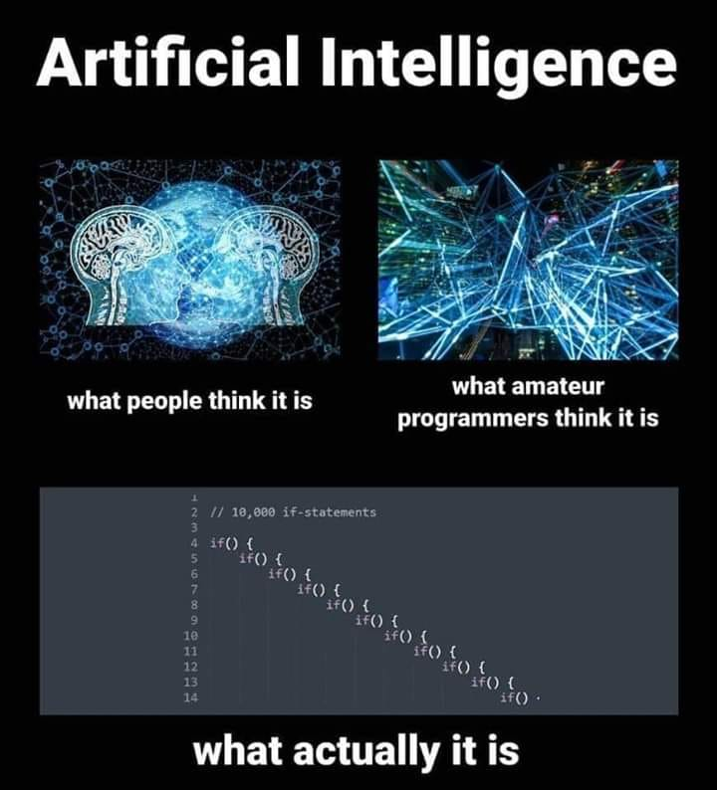

Slide 6
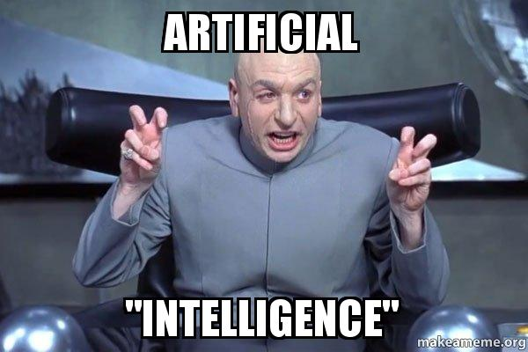
What is AI
“Artificial intelligence, sometimes called machine intelligence, is intelligence demonstrated by machines, in contrast to the natural intelligence displayed by humans and other animals.” – Google
- Intelligence? -- “the ability to acquire and apply knowledge and skills.”

Slide 7

AI vs ML vs DL

Slide 8
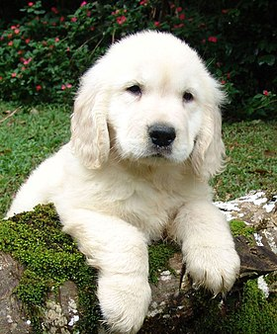
Why Machine Learning?
What makes a “dog” a dog??

Slide 9
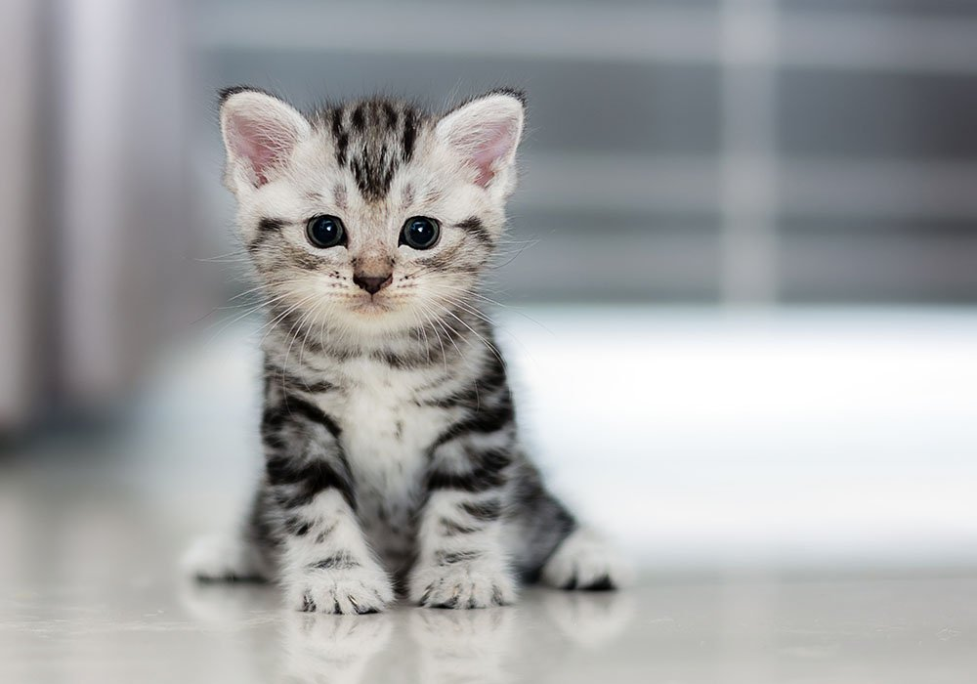
and a “cat” a cat??

Slide 10
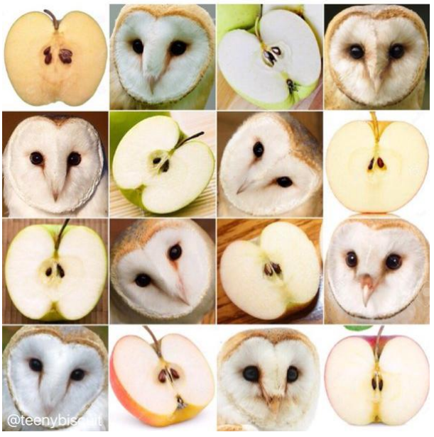
Barn owl or an Apple??

Slide 11
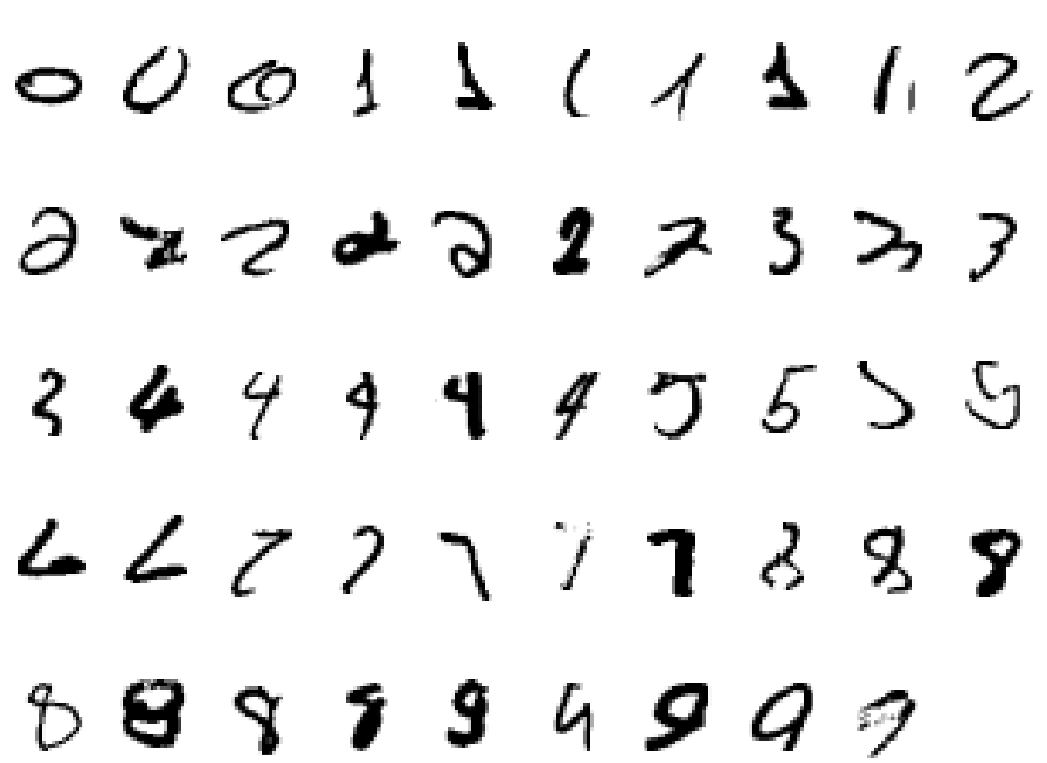
What makes a 2??

Slide 12
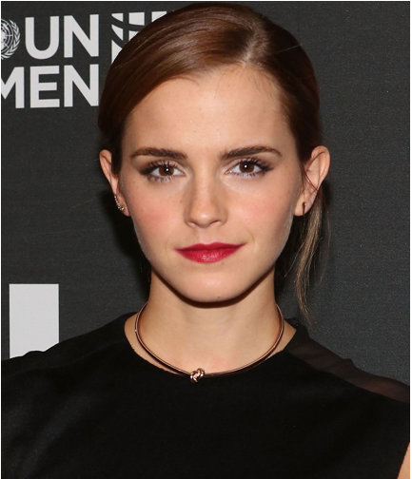
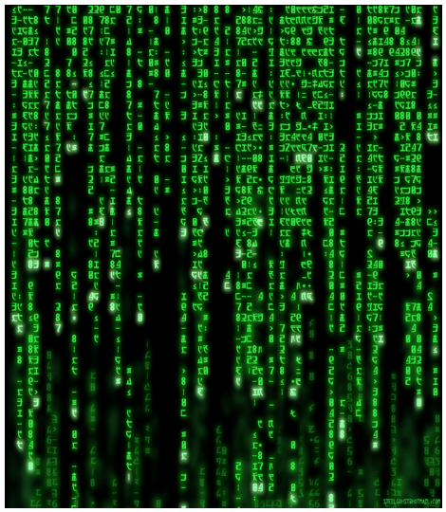
Besides….
What you see What your machine sees

Slide 13
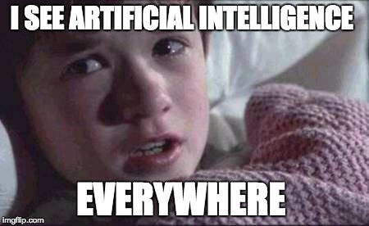
Applications

Slide 14
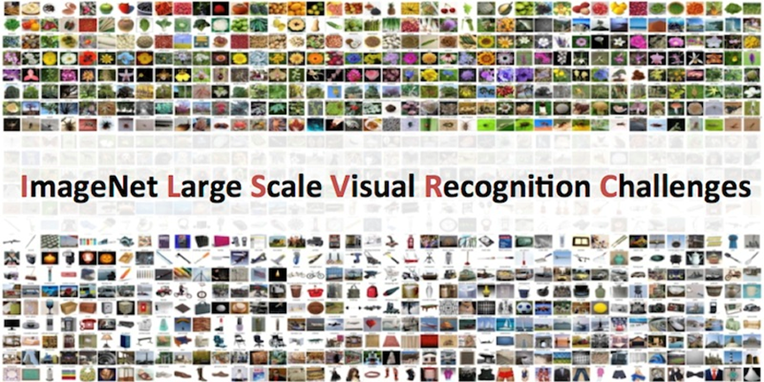
Image Classification

Slide 15
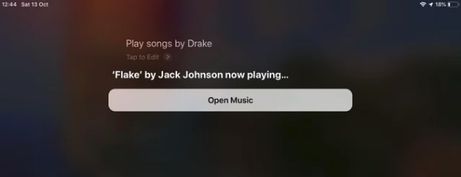
Natural Language Processing

Slide 16
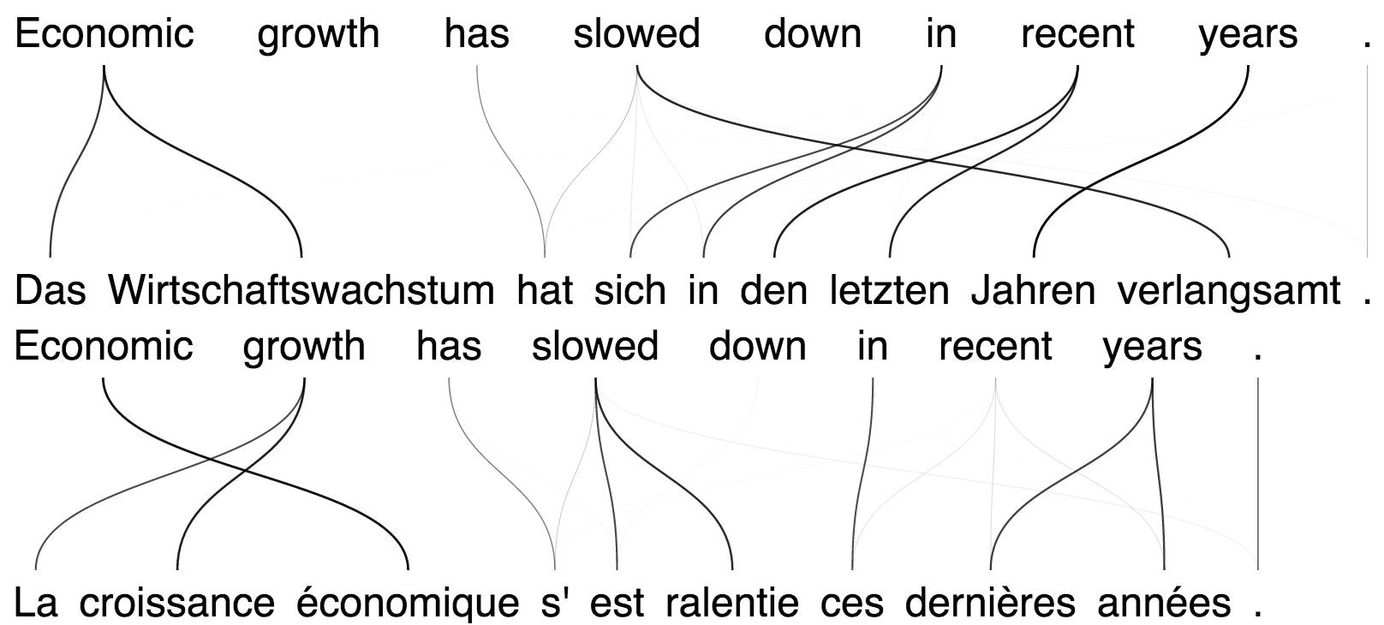

Slide 17
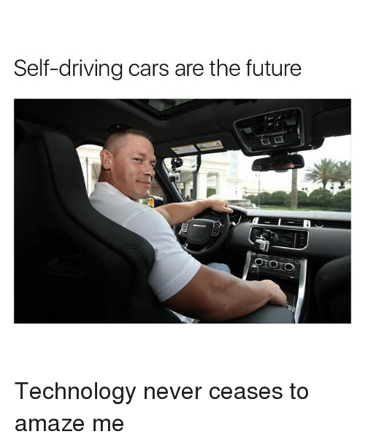
Self Driving Cars

Slide 18
More than 50 startups have the rights to test autonomous cars in California!
MIT runs a course too - MIT 6.S094: Deep Learning for Self-Driving Cars

Slide 19
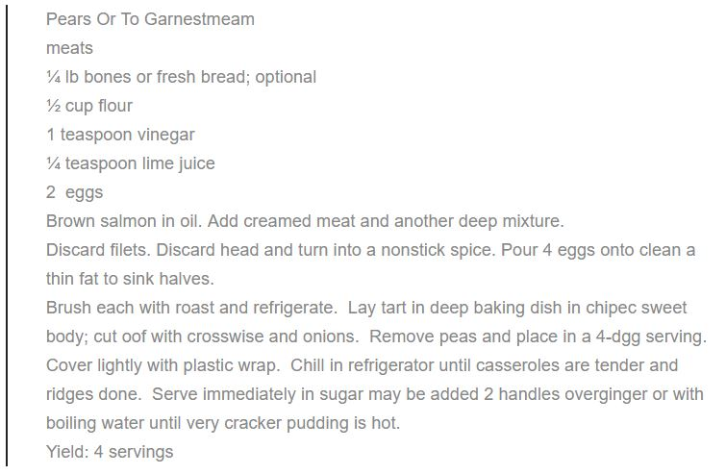
Some more….
Machine Learning Models can also,
Make Recipes.

Slide 20
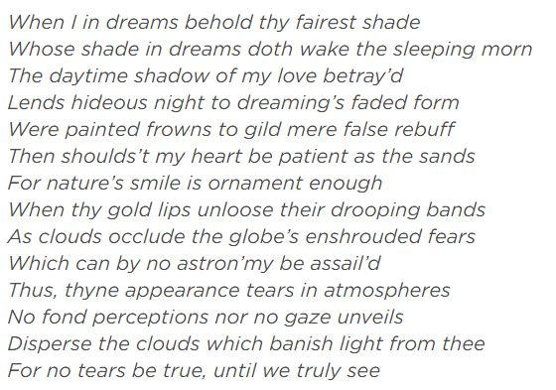
Some more….
Machine Learning Models can also,
Do Poetry.

Slide 21
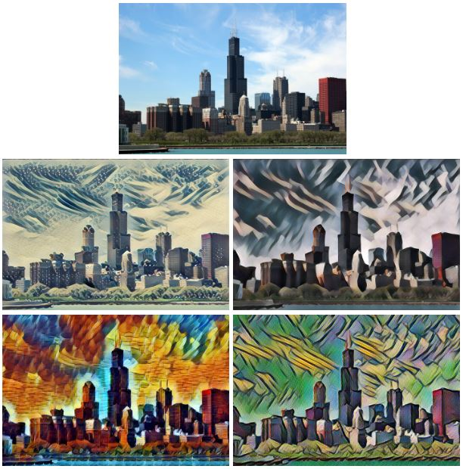
Some more….
Machine Learning Models can also,
Paint.

Slide 22

Some more….
Machine Learning Models can also,
Make Music.

Slide 23
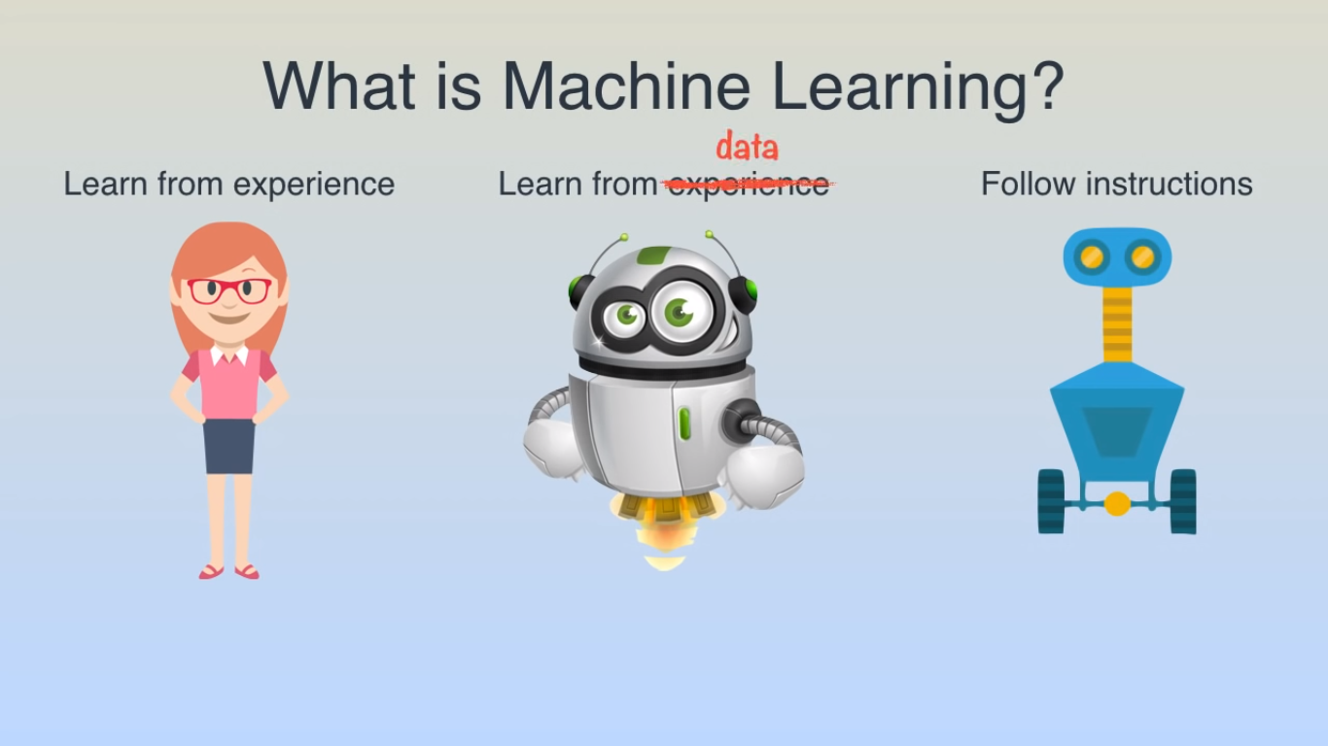
Notes:
<number>

Slide 24
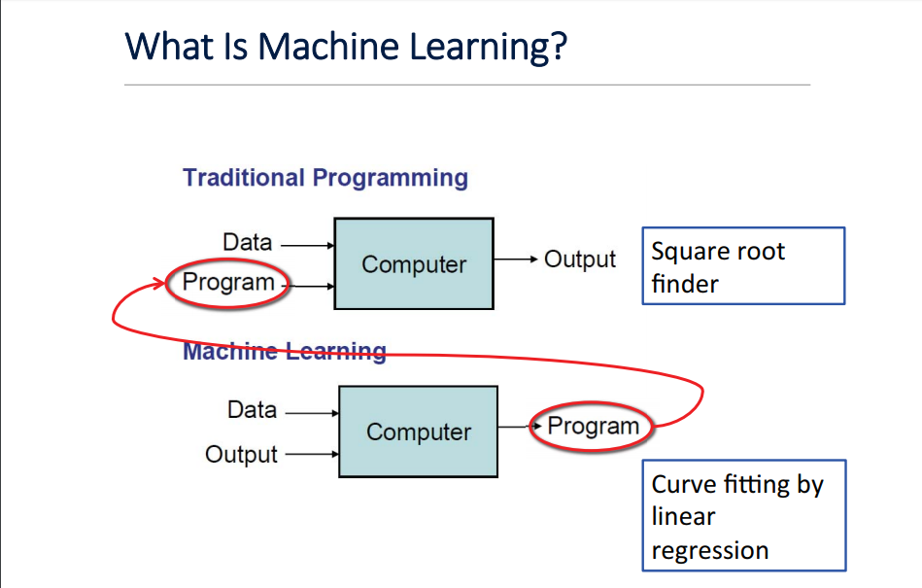

Slide 25
How are things learned?
- Memorization
- Generalization -> Deduce new facts from old
- Interested in extending to programs that can infer useful information from implicit patterns in data

Slide 26
Machine Learning as Pattern Analysis
Sessional | Final Exam | Result
25 | 25 | Pass
31.1 | 30 | Pass
29.7 | 14 | Fail
39.1 | 25 | Pass
28.9 | 21 | Fail
46.3 | 40 | Pass
30.55 | 21 | ??

Slide 27
Machine Learning as Pattern Analysis
Sessional | Final Exam | Result
25 | 25 | Pass
31.1 | 30 | Pass
29.7 | 14 | Fail
39.1 | 25 | Pass
28.9 | 21 | Fail
46.3 | 40 | Pass
30.55 | 21 | Pass

Slide 28
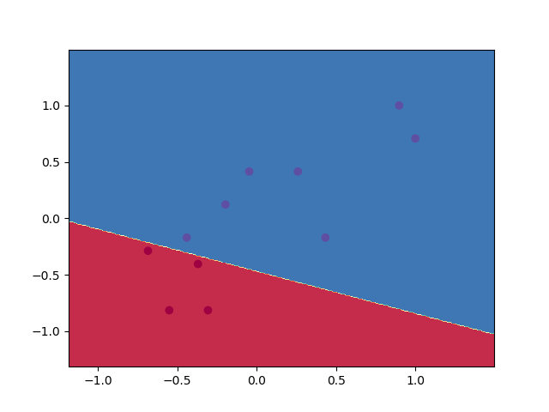

Slide 29
Machine Learning as Pattern Analysis
Planet | Periodicity | Distance
Mercury | 0.24 | 0.39
Venus | 0.62 | 0.72
Earth | 1.00 | 1.00
Mars | 1.88 | 1.52
Jupiter | 11.86 | 5.20
Saturn | 29.42 | 9.54
Uranus | 84.32 | ??

Slide 30
Machine Learning as Pattern Analysis
Planet | Periodicty | Distance
Mercury | 0.24 | 0.39
Venus | 0.62 | 0.72
Earth | 1.00 | 1.00
Mars | 1.88 | 1.52
Jupiter | 11.86 | 5.20
Saturn | 29.42 | 9.54
Uranus | 84.32 | 19.22

Slide 31
Basic Paradigm
Observe set of examples: Training Data
Infer Something from the process that generated that data
Use Inference to make predictions on new data: Test Data

Slide 32
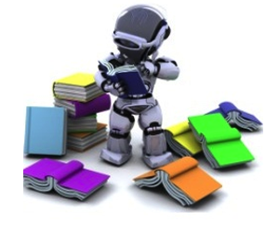
Supervised Learning
Training data includes both the input and desired output/result.
Data = {(x⁽¹⁾, y⁽¹⁾), (x⁽²⁾, y⁽²⁾), … ,(x^{(m)}, y^{(m)})}
Target
Error
Supervised Learning
Input
Output

Slide 33
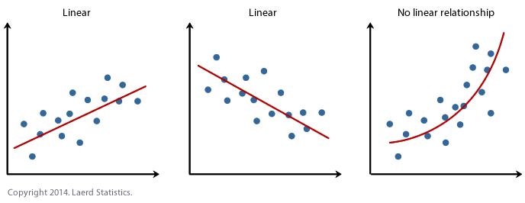
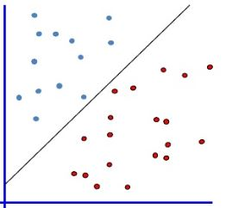
Supervised Learning
Regression Classification

Slide 34
Applications
Face Recognition
Speech Recognition
Character Recognition
Predictive Analysis
1

Slide 35
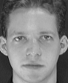


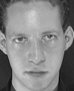

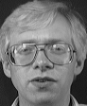
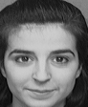
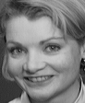
Face Recognition
Training examples of a person
Test images
Notes:
<number>

Slide 36
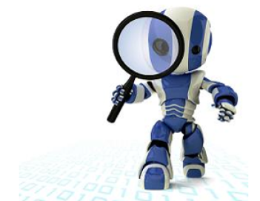
Unsupervised Learning
Training data does not include desired labels. output/result.
Data = {(x⁽¹⁾), (x⁽²⁾), … ,(x^{(m)})}
Unsupervised Learning
Input
Output

Slide 37
Clustering
Clustering is a technique for finding similarity groups in data, called clusters. I.e.,
it groups data instances that are similar to (near) each other in one cluster and data instances that are very different (far away) from each other into different clusters.

Slide 38
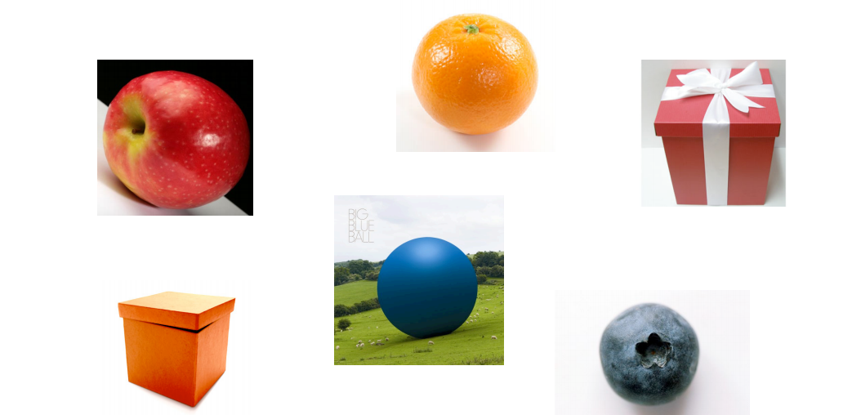
Clustering

Slide 39
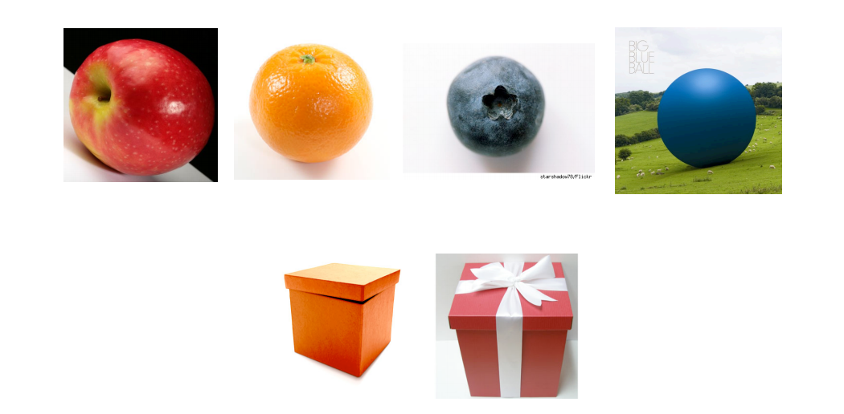
Cluster Analysis

Slide 40
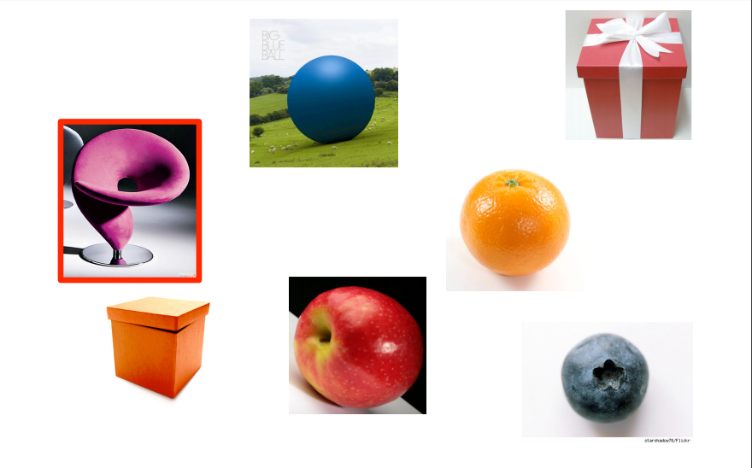
Finding Outliers

Slide 41
What is Clustering For?
Let us see some real-life examples
Example 1: groups people of similar sizes together to make “small”, “medium” and “large” T-Shirts.
Tailor-made for each person: too expensive
One-size-fits-all: does not fit all.

Slide 42
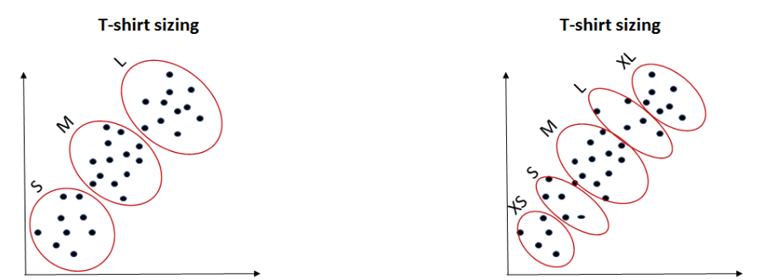
Clustering Example

Slide 43
Other applications
Customer segmentation in CRM
Anomaly Detection
<number>

Slide 44
Too Easy?
If sessional + final > 50:
grade = 1
else:
grade = 0

Slide 45
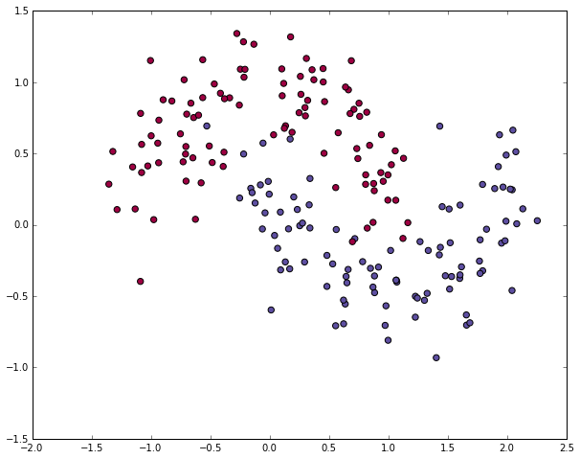
How about this one?

Slide 46
Feature Spaces
Q1 | Q2 | Q3 | P1 | M1 | M2 | Final | Result
5 | 5 | 5 | 2.5 | 15 | 15 | 25 | Pass
5 | 0 | 7 | 3 | 20 | 21 | 30 | Pass
3 | 6 | 5 | 3 | 17 | 22 | 14 | Fail
6 | 4 | 6 | 4.25 | 25 | 25 | 25 | Pass
7 | 8 | 6 | 2.5 | 15 | 19 | 21 | ??
Can you now Guess whether the student passed or failed?

Slide 47
Q1 | Q2 | Q3 | P1 | M1 | M2 | Final | Result
5 | 5 | 5 | 2.5 | 15 | 15 | 25 | Pass
5 | 0 | 7 | 3 | 20 | 21 | 30 | Pass
3 | 6 | 5 | 3 | 17 | 22 | 14 | Fail
6 | 4 | 6 | 4.25 | 25 | 25 | 25 | Pass
7 | 8 | 6 | 2.5 | 15 | 19 | 21 | Fail
Sessional | Final Exam | Result
25 | 25 | Pass
31.1 | 30 | Pass
29.7 | 14 | Fail
39.1 | 25 | Pass
28.9 | 21 | Fail

Slide 48
Demo
Notes:
Introduce the concept of linearly seperable data..and how most of the data is not linearly seperable
Talk about how the data which isn't linearly seperable in one space can be linearly seperable in another(example se hi explain krunga)
Demo
<number>

Slide 49
Summary
ML is all about Pattern Analysis
Supervised Learning : Classification/Regression
Unsupervised Learning: Clustering
Learning Non-linear Boundaries

Slide 50

But…

Slide 51
What now?
Our facebook group will go live today! Join it to know more!
Next Session:
Delving into Data Science – A 2 hour blitz!

